Slide 1
How to Set up a Theme for Jupyter Slides
Rita Rozental
Notes:
Be specific and direct in the title. Use the subtitle to give the specific context of the speech.
-The goal should be to capture the audience’s attention which can be done with a quote, a startling statistic, or fact. It is not necessary to include this attention getter on the slide.

Slide 2
There are many existing themes available at https://revealjs.com/themes/. But do not use the GitHub link at the bottom of this website to download them – it has .scss file format which will not work!
Notes:
Dedicate this entire slide to the thesis statement. It is the reason the speech is being given. Use this time to reveal the three main points of the speech (slides 4,5,6) as an overview for the direction of the speech:
-[type main point #1 here]
-[type main point #2 here]
-[type main point #3 here]
Be sure to transition to the first main point and the next slide.

Slide 3
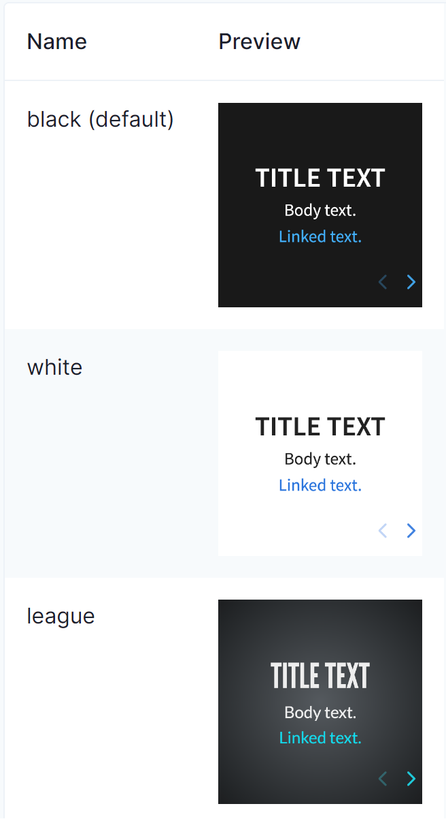
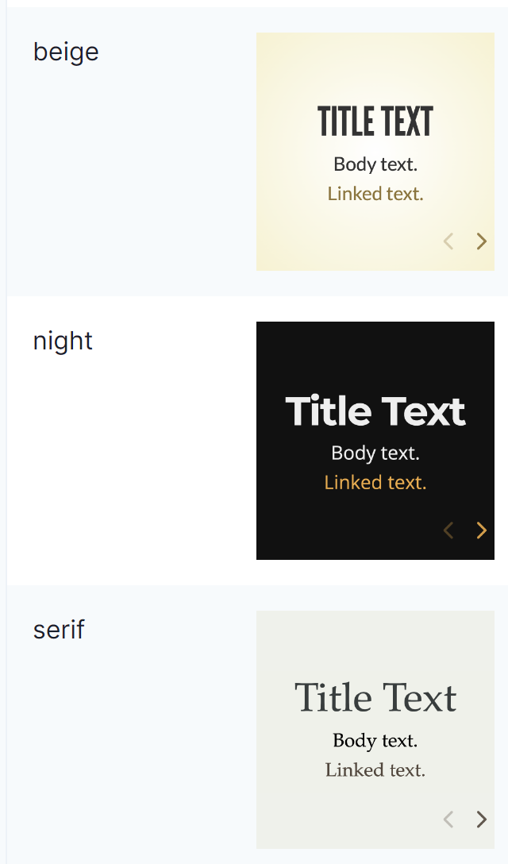
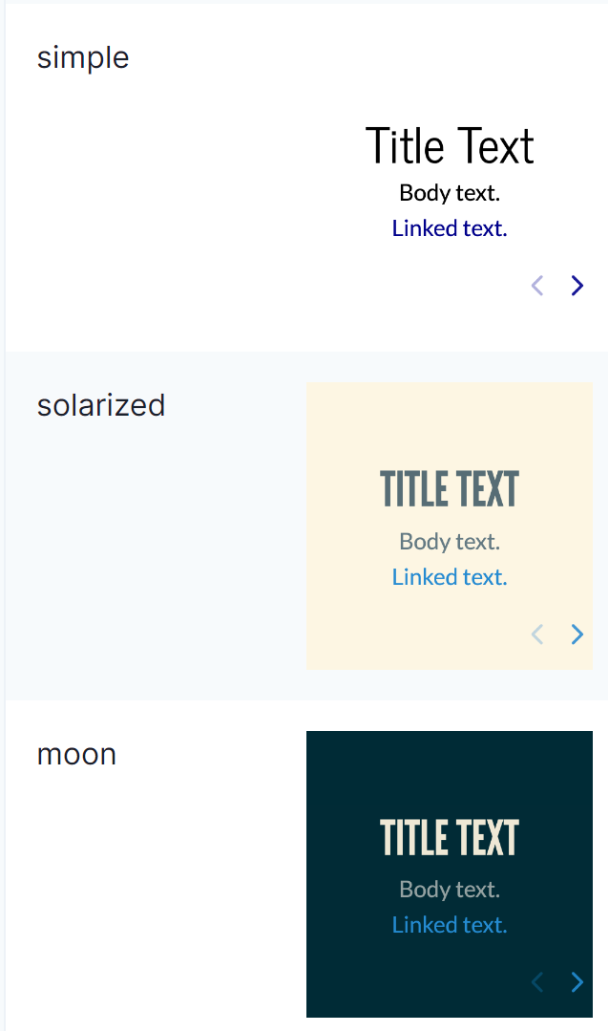
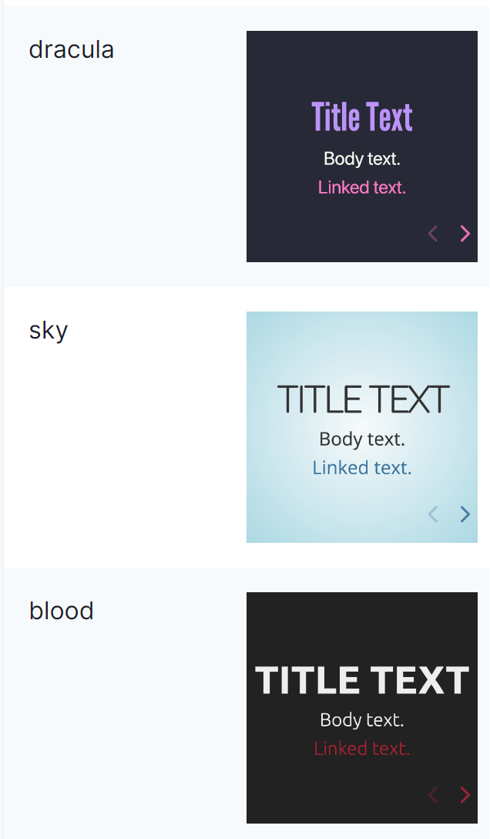
https://revealjs.com/themes/
Notes:
Use the background points to post details that are not common knowledge, or that the audience will need to understand the context of the speech.
-Do not read these main points from the PowerPoint, instead elaborate on these points during the speech.

Slide 4
Use https://revealjs.com/themes/ only to see what the themes look like. Once you have selected your theme, got to https://cdnjs.com.
Notes:
Dedicate this entire slide to the thesis statement. It is the reason the speech is being given. Use this time to reveal the three main points of the speech (slides 4,5,6) as an overview for the direction of the speech:
-[type main point #1 here]
-[type main point #2 here]
-[type main point #3 here]
Be sure to transition to the first main point and the next slide.

Slide 5
On cdnjs, search for reveal.js and look for the theme files in the list (they usually end in .css). or use the link below: https://cdnjs.com/libraries/reveal.js
Notes:
Dedicate this entire slide to the thesis statement. It is the reason the speech is being given. Use this time to reveal the three main points of the speech (slides 4,5,6) as an overview for the direction of the speech:
-[type main point #1 here]
-[type main point #2 here]
-[type main point #3 here]
Be sure to transition to the first main point and the next slide.

Slide 6
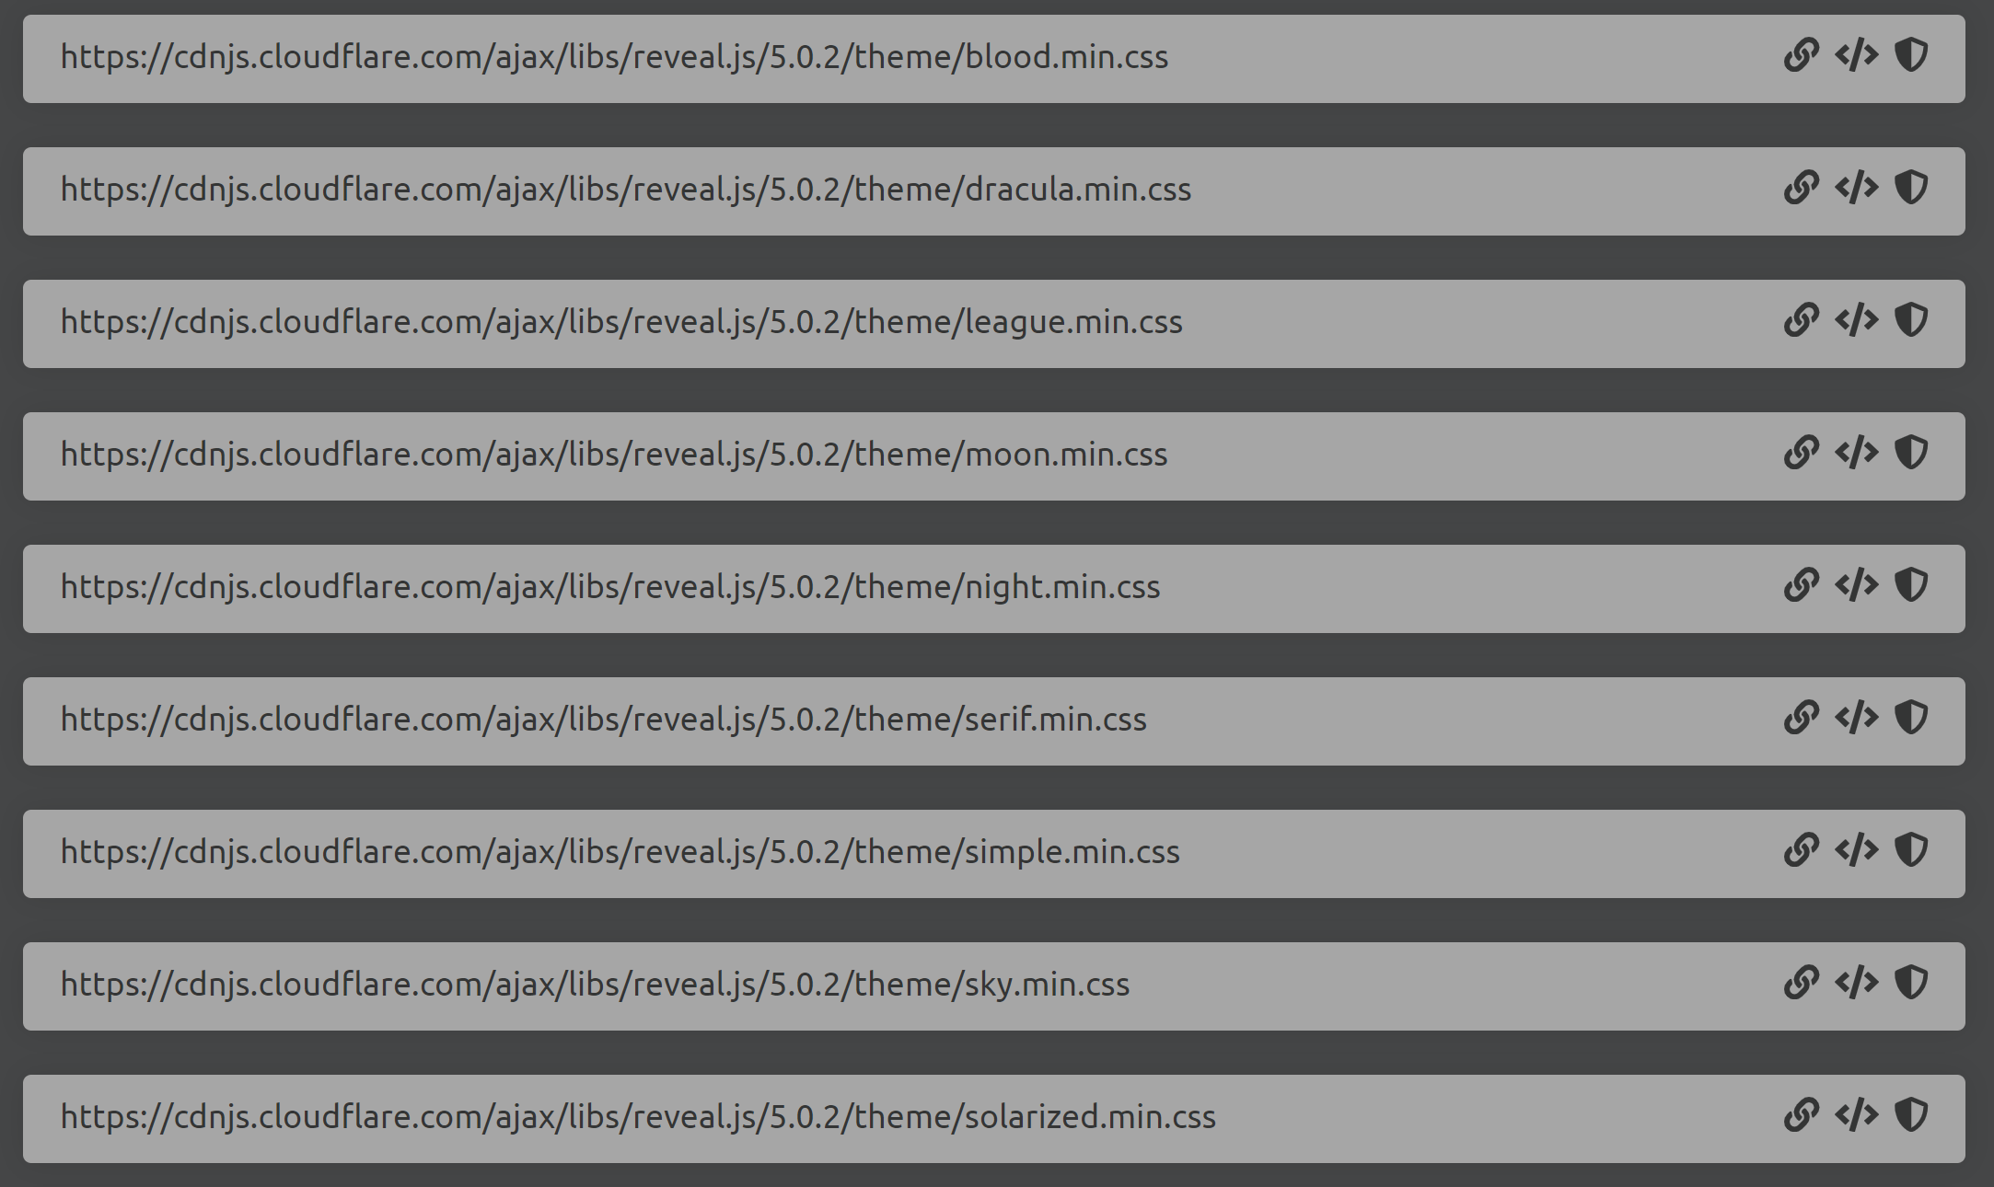
https://cdnjs.com/libraries/reveal.js
Notes:
The title of main point #2 should be clear and concise. Each piece of evidence should be summarized for clarity and cited correctly. Do not simply read the pieces of evidence, but elaborate where needed.
[type notes for elaboration here]
Be sure to transition to main point #3 and the next slide.

Slide 7
Pick a theme from the list on the previous slide. Copy the link for your theme and past it into a new window.
Notes:
Dedicate this entire slide to the thesis statement. It is the reason the speech is being given. Use this time to reveal the three main points of the speech (slides 4,5,6) as an overview for the direction of the speech:
-[type main point #1 here]
-[type main point #2 here]
-[type main point #3 here]
Be sure to transition to the first main point and the next slide.

Slide 8

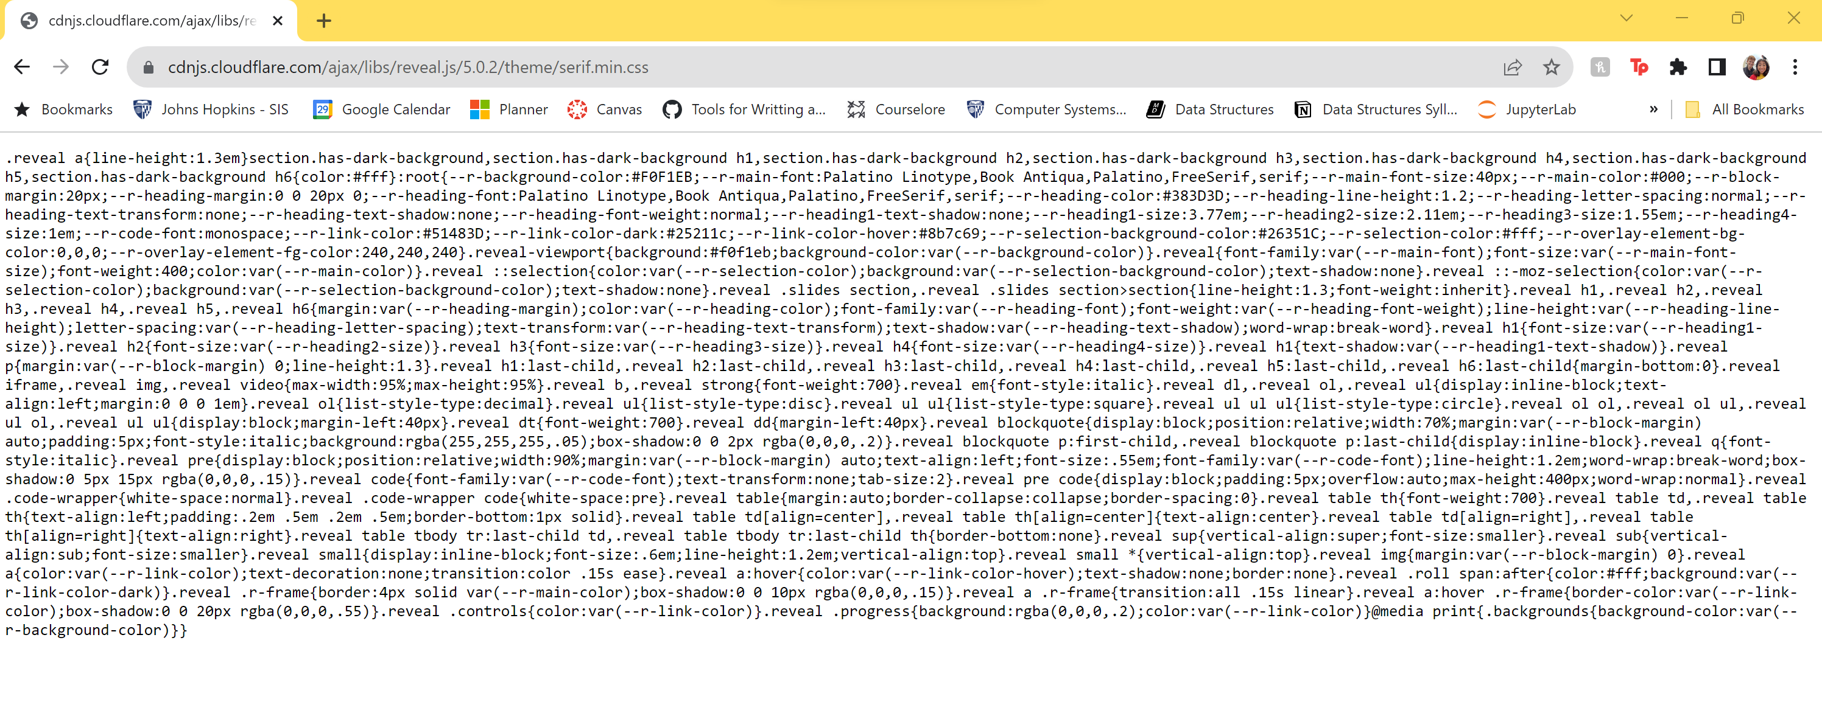
https://cdnjs.cloudflare.com/ajax/libs/reveal.js/5.0.2/theme/serif.min.css
Notes:
The title of main point #2 should be clear and concise. Each piece of evidence should be summarized for clarity and cited correctly. Do not simply read the pieces of evidence, but elaborate where needed.
[type notes for elaboration here]
Be sure to transition to main point #3 and the next slide.

Slide 9
Copy and paste all the text from your .css file into a new code cell at the very top of your Jupyter Notebook.
Notes:
Dedicate this entire slide to the thesis statement. It is the reason the speech is being given. Use this time to reveal the three main points of the speech (slides 4,5,6) as an overview for the direction of the speech:
-[type main point #1 here]
-[type main point #2 here]
-[type main point #3 here]
Be sure to transition to the first main point and the next slide.

Slide 10
Now we need to embed your .css file directly in a %%html cell at the beginning of your notebook.
Notes:
Dedicate this entire slide to the thesis statement. It is the reason the speech is being given. Use this time to reveal the three main points of the speech (slides 4,5,6) as an overview for the direction of the speech:
-[type main point #1 here]
-[type main point #2 here]
-[type main point #3 here]
Be sure to transition to the first main point and the next slide.

Slide 11
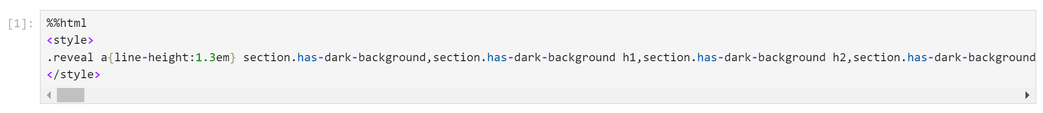
%%html<style> Copy and Paste text from your .css file here! </style>A
Example:
Notes:
The title of main point #2 should be clear and concise. Each piece of evidence should be summarized for clarity and cited correctly. Do not simply read the pieces of evidence, but elaborate where needed.
[type notes for elaboration here]
Be sure to transition to main point #3 and the next slide.

Slide 12
Note: you might have to pip install RISE if you have not already!
Notes:
Dedicate this entire slide to the thesis statement. It is the reason the speech is being given. Use this time to reveal the three main points of the speech (slides 4,5,6) as an overview for the direction of the speech:
-[type main point #1 here]
-[type main point #2 here]
-[type main point #3 here]
Be sure to transition to the first main point and the next slide.

Slide 13
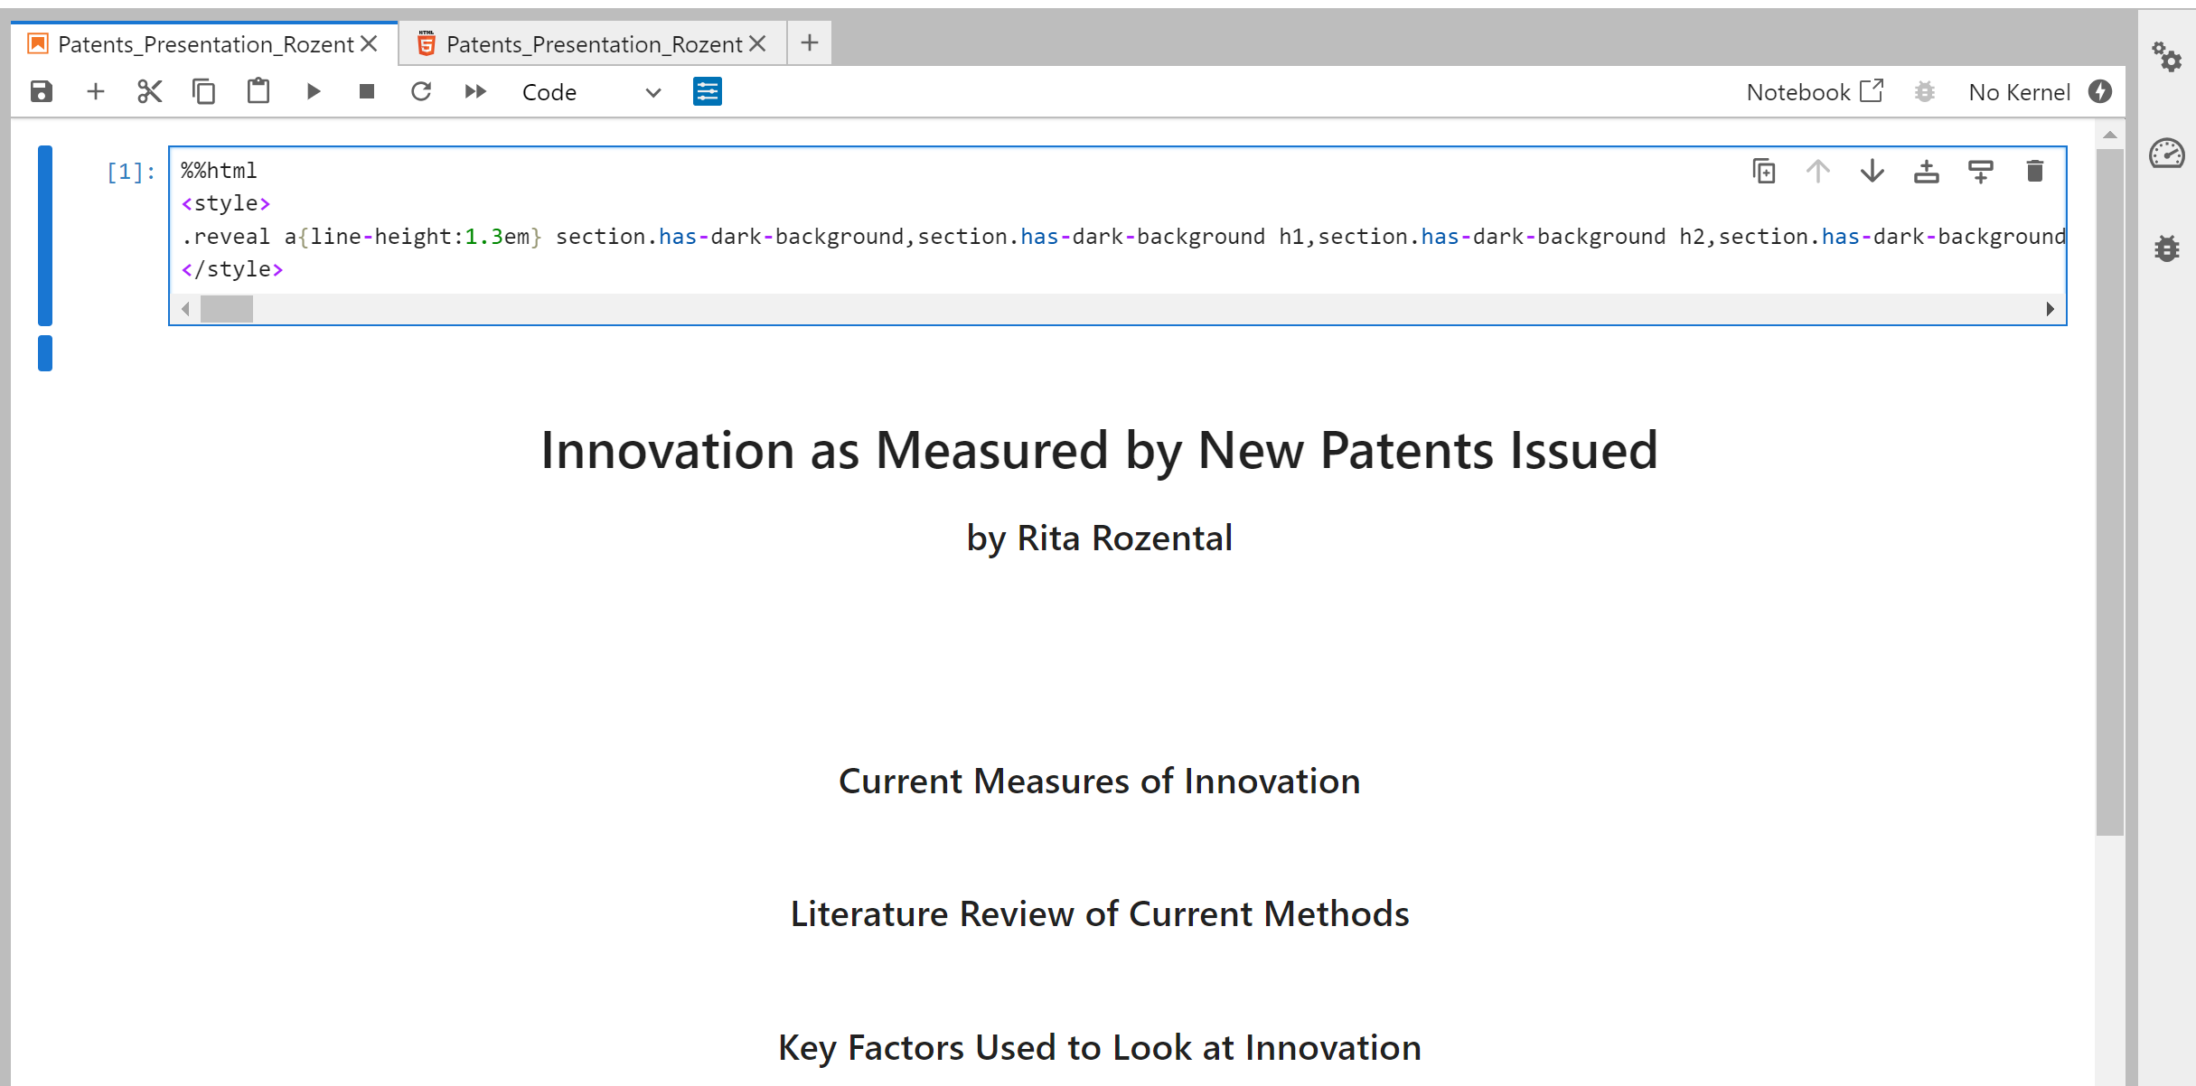
Next, add RISE Configurations to Notebook Metadata

Slide 14
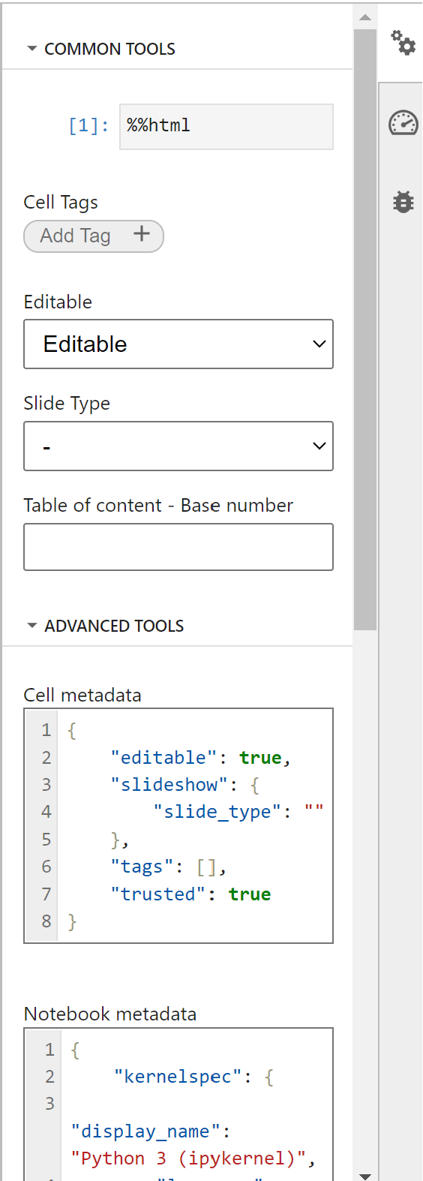
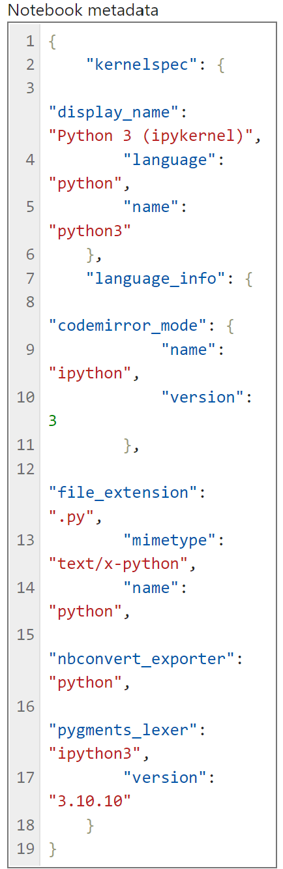
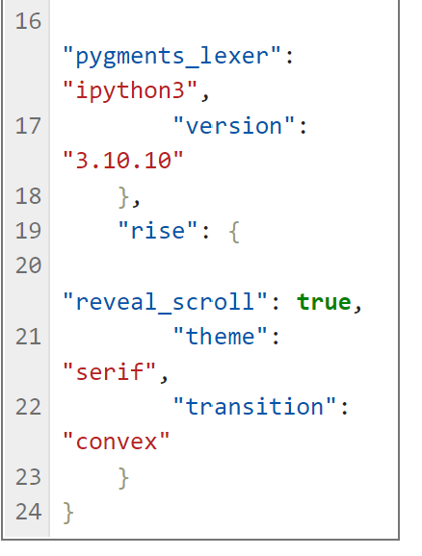
Scroll to bottom of “Notebook meta data”. The screenshot on the left is your current code. The screenshot below is what the updated code should look like.
Add the following code from line 19 to 24 to your “Notebook metadata”. Replace “serif” with your theme name if you picked a different theme.

Slide 15
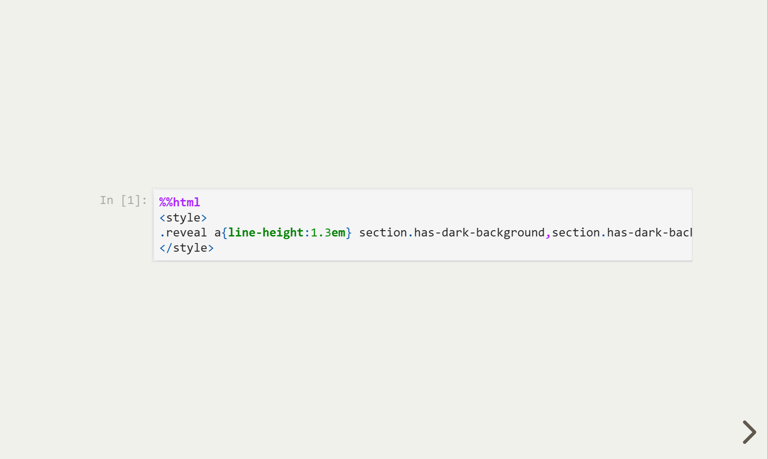

Save and you should now have:

Slide 16
Now we just have to hide the first slide!
Notes:
The title of main point #2 should be clear and concise. Each piece of evidence should be summarized for clarity and cited correctly. Do not simply read the pieces of evidence, but elaborate where needed.
[type notes for elaboration here]
Be sure to transition to main point #3 and the next slide.

Slide 17
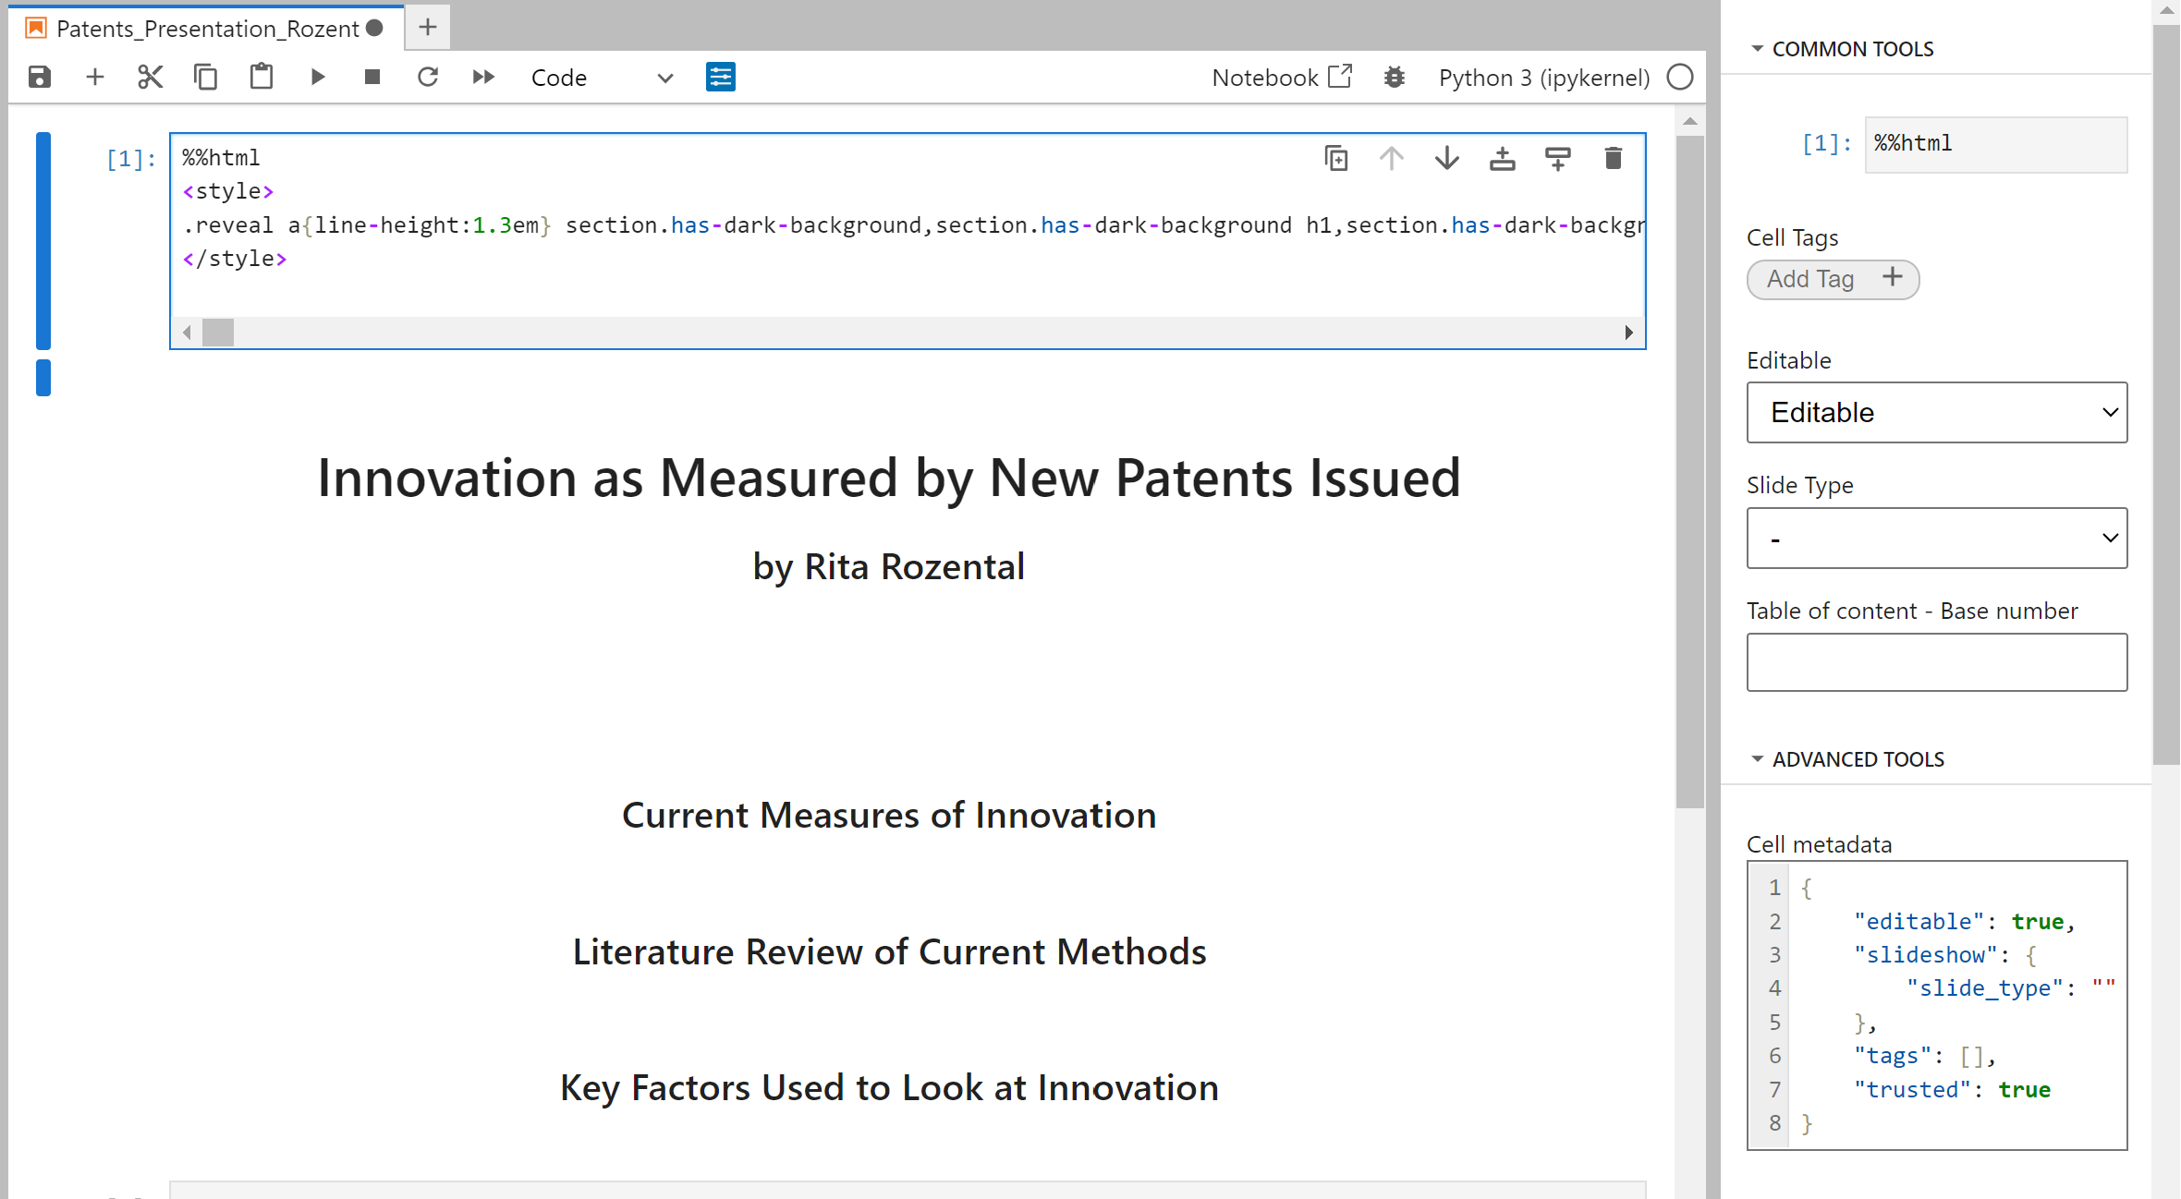
Select code cell and open settings

Slide 18
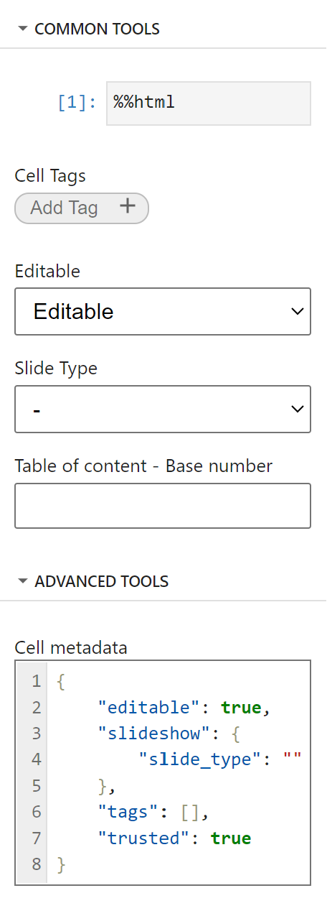
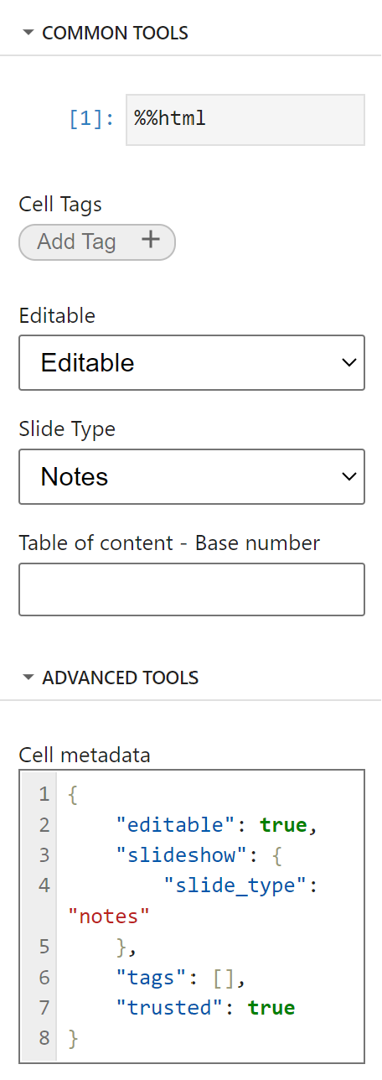
Change cell metadata
Change:
To

Slide 19

Save and you’re done!

